Slide 1
The University of Portsmouth implements the use of Emotion AI in Zoom meetings to draw a better judgement on the students’ understanding

Slide 2


Introduction to the University of Portsmouth
A public UK University in the city of Portsmouth
Known for being in the top 30 universities for student satisfaction
During the coronavirus pandemic the university has faced difficulties in engaging their students during their zoom meetings as if they are on-campus
Problem: The university perceives Zoom as a non-engaging platform such as face-to-face sessions and interactions that take place on-campus regularly
Lecturers may find it difficult to engage with the students as not all students open their cameras (Dhawan, 2020)
Reduced interactions and engagement between the students and lecturers may result in lower grades and lower student satisfaction (Ferlazzo, 2020)

Slide 3

Introduction to Emotion AI (Artificial Intelligence)
Emotion AI uses AI to analyse the emotional state of a person through the use of cameras, recording voice, sensors and software logic (Harbour, 2020)
Computer vision algorithms recognise the main points of a human’s face such as the eyes, nose, mouth etc. and decodes it
Emotion AI has been mainly used for testing on consumers and how they react to a product or a commercial

Slide 4
Zoom & Emotion AI
Zoom a leader in modern communication has the capability of offering more
In current times the pandemic has made It difficult for the education sector proceed with their teaching as usual
Students find it more difficult and challenging to stay engaged within the lecture itself, therefore affecting their overall academic performance (Fischer et al., 2020)
Lecturers cannot determine if the crowd they are communicating to is engaged or not
The University of Portsmouth can implement Emotion AI which is capable of reading facial expressions and analysing them according to preference
Proposed solution
Emotion AI could monitor and record students’ facial expressions and analyse them in order to decide if they are engaged and do understand
Throughout the teaching block Emotion AI would have built a profile on each student
This could help lecturers in identifying students who do not understand or are not engaged.
Therefore, lecturers could offer them more support
As a result an increased student satisfaction and a better academic performance by the students
Gartner. Maverick* Research: Emotion AI Will Become You Without Your Knowledge. (2019). Retrieved from https://www.gartner.com/document/3975557?ref=solrAll&refval=268921259

Slide 5
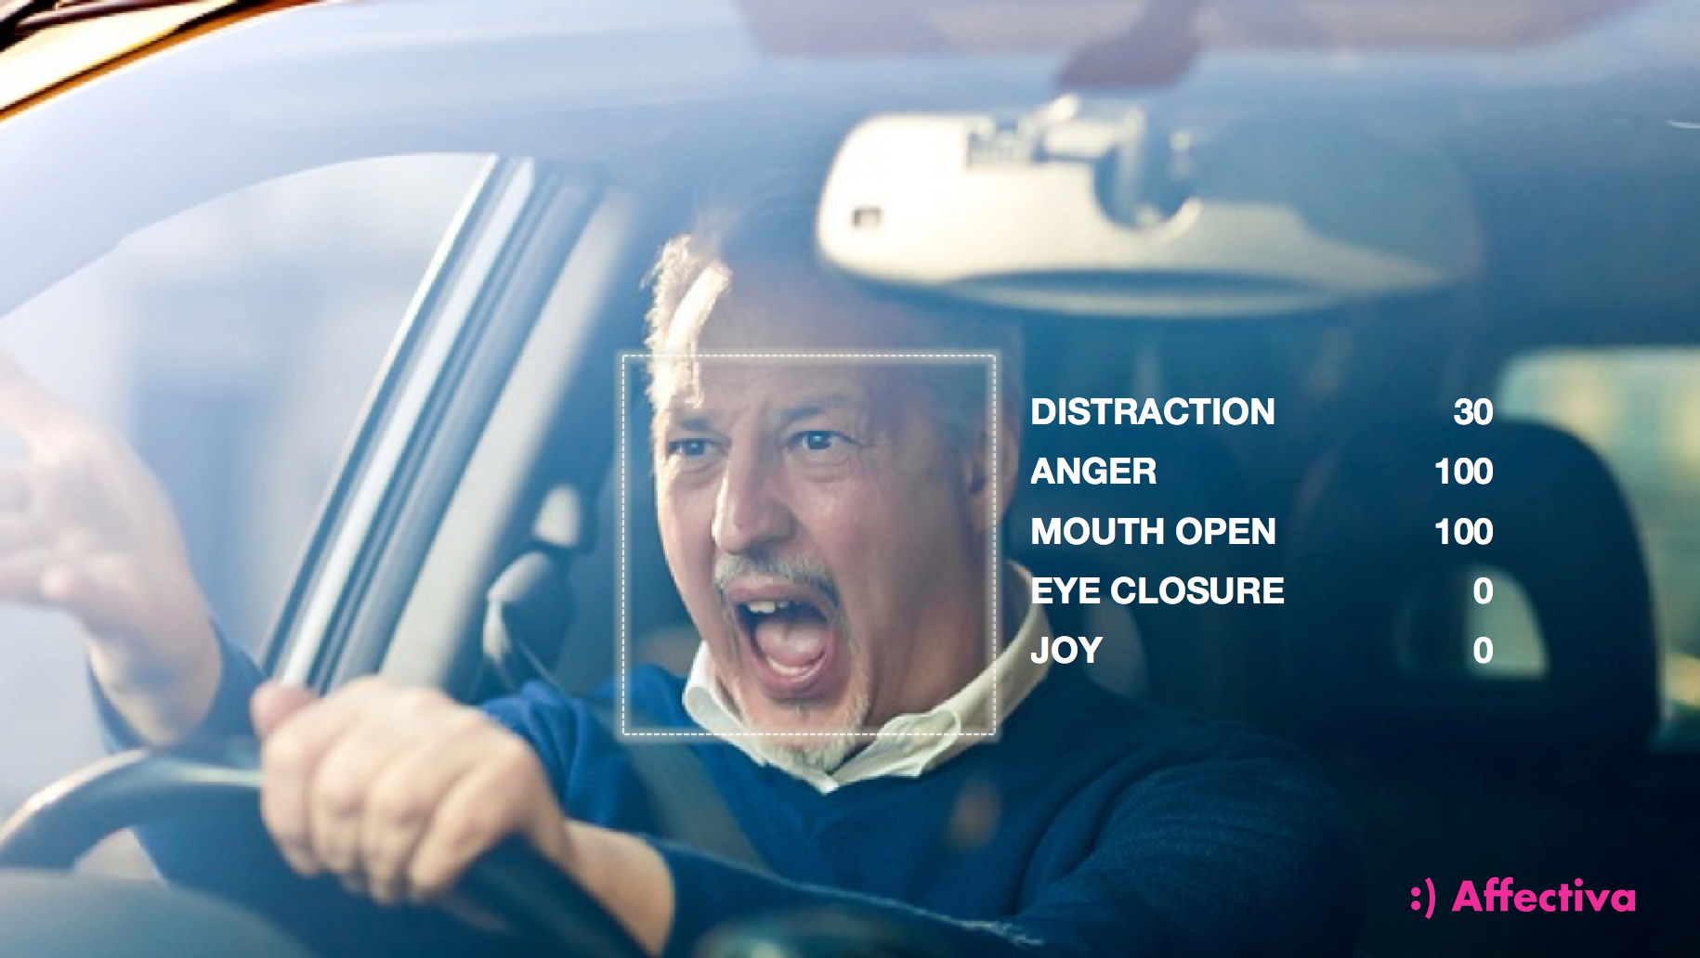
Emotion AI implemented in Zoom meetings
Emotion AI is in the process of being implemented for commercial use
Affectiva- Is a website that can read your face and show you what the emotion AI has analysed from your face
Affectiva is still in its demo phase (https://www.affectiva.com)
Kairos is an AI engine provider in facial recognition (https://www.kairos.com)
Emotion AI is currently in the phase of “innovation trigger” this indicates it hasn’t been fully explored yet
Emotion AI throughout time could learn different behaviours and facial expressions and developing its skills
It is expected that Emotion AI will greatly help in the educational sector as it will improve the understandability of the students

Slide 6
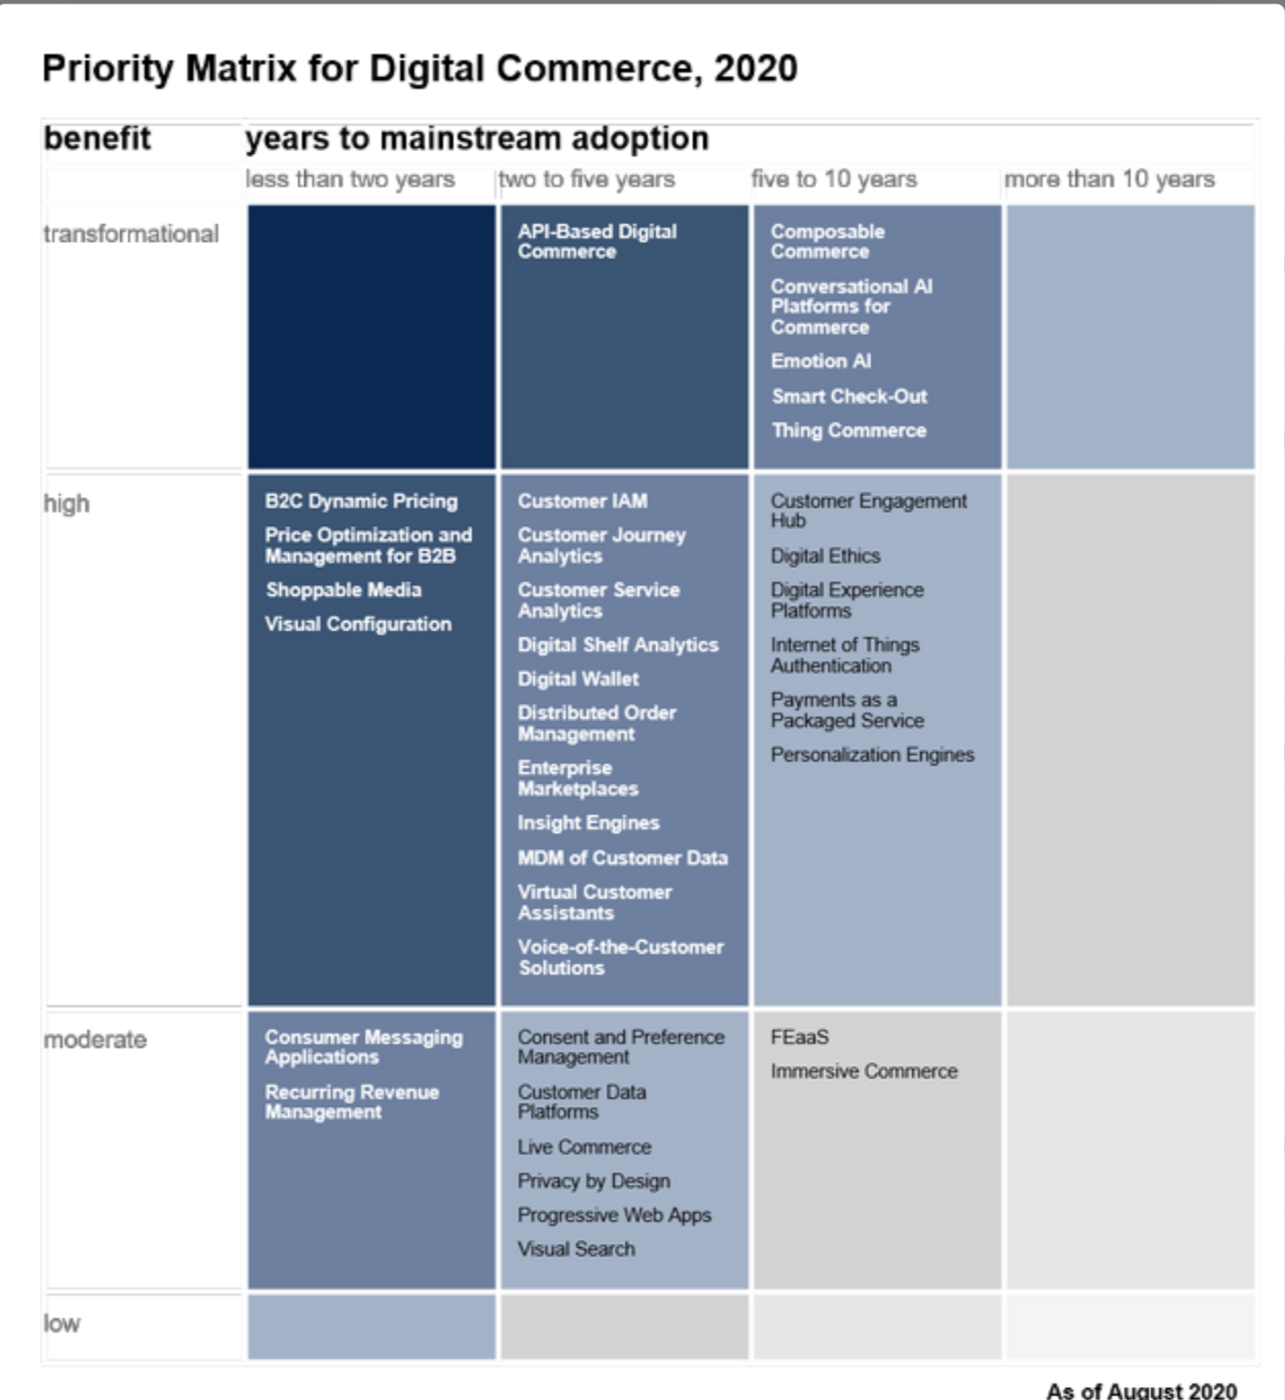
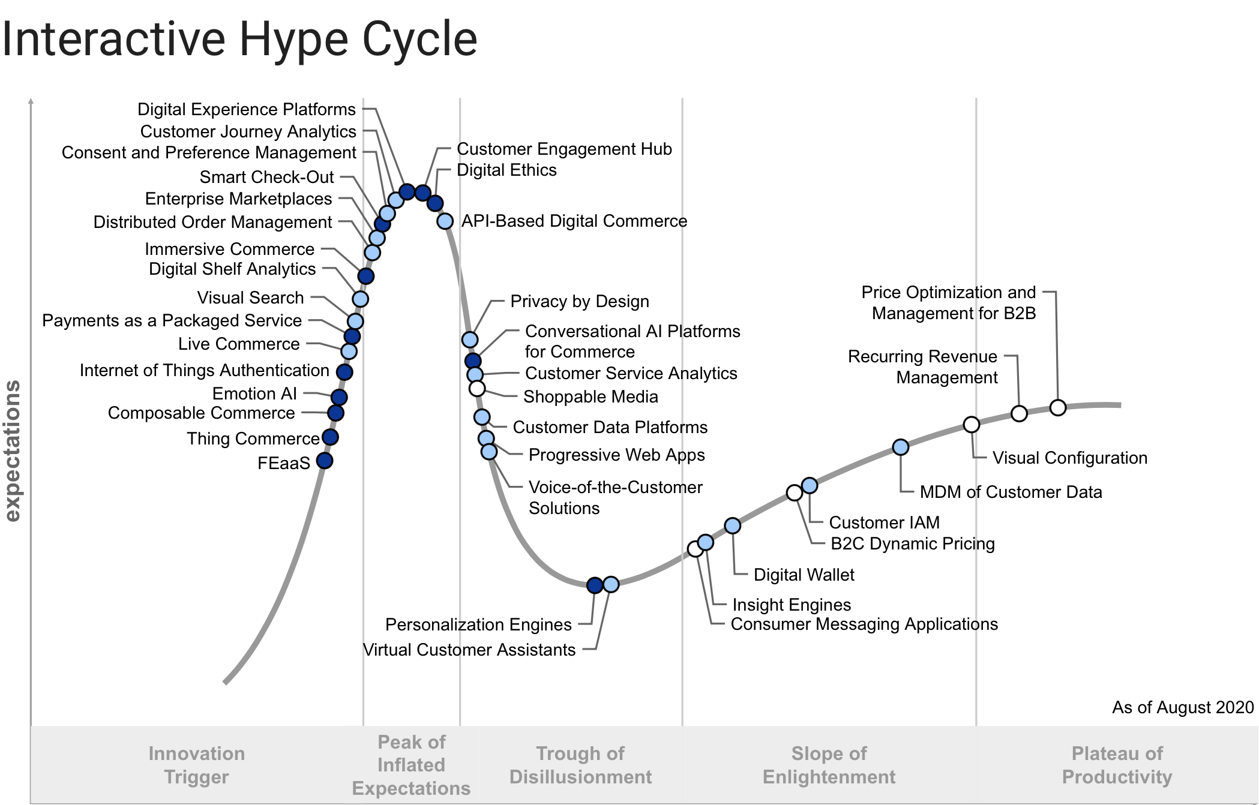
Gartner: Anticipated Future Development
By the year 2020 a lot of products are using Emotion AI like features such smart speakers with voice recognition or Facial recognition.
In the year 2025 the Gartner priority matrix has anticipated that Emotion AI will be implemented fully within 5 to 10 years
Vendors that are working with Emotion AI are Affectiva, Behavioural Signals, Google and Microsoft and will have a transformational effect across many industries.
Emotion AI’s market penetration is less than 1% and is the emerging phase of maturity. This indicates a simpler way of entering the market without any barriers
2025, Customer Journey Analytics (CJA) is the process to track and analyse the way customers reacts through different combinations of communications channels. CJA and Emotion AI could work simultaneously to achieve the best combination in trying to understand the consumer
Timeframe | Anticipated future development | Anticipated enhancement
2022 | Consumer Messaging applications within the university | A better engagement of the consumer of what the problem might be through messaging.
2025 | Customer Journey Analytics (CJA) | This could help Emotion AI in communicating with the student and taking multiple combinations for a better profile. This will help in redirecting them to better sources that could help them according to preference
Gartner. Hype Cycle for Digital Commerce (2020). Retrieved from https://www.gartner.com/document/3988357?ref=solrAll&refval=268862012

Slide 7
The value of using Emotion AI in Zoom meetings
Value to the consumer
University have a better understanding of their students during this pandemic
Therefore, a more on-campus (virtual) environment could be provided by the university to their students (Fischer et al., 2020)
This will result in a higher student satisfaction
Timeframe: Achievable now however limited
Value to the University:
As a result, gaining a higher rank among other universities which leads to more students registering at the University thus more profit
Students are understanding better therefore higher student satisfaction (Fischer et al., 2020)
Better engagement and communication between the university and the student to understand their needs and wants

Slide 8
Sustainability, Ethical considerations and Risks
Economic sustainability
A possible risk that online classes with the implementation of Emotion AI could fully replace on-campus teaching (could affect other industries)
Societal sustainability:
Emotion AI is not sophisticated to understand different cultures and emotions as some cultures perceive specific emotions different than others (Purdy et al., 2019)
Environmental sustainability
Reduced use of personal and public travel which will reduce the carbon footprint (NEC, 2018)
Ethical concerns
Students may feel uncomfortable that they are being monitored throughout the whole lecture
Using Emotion AI could be seen as a violation of privacy and the student is to decide whether or not to participate in being monitored

Slide 9
Sustainability, Ethical considerations and Risks
OECD Principle | Application
Collection Limitation | The implementation of Emotion AI in Zoom meetings must not collect more data than intended in their terms of use
Data Quality | Data recorded must be accurate and fair according to use
Purpose specification | The student must be informed and fully aware of what the data is being used for
Security safeguards | Emotion AI and Zoom software must secure the data collected
Use limitation | The data collected must not be used again after they have served what they are needed for
Openness | This is a field of concern to the students of how their information is being used for educational purposes
Individual participation | The student has the ability not to participate in being monitored for educational purposes
Accountability | Zoom and the University should be accountable for their actions in the use of Emotion AI
Stakeholder Analysis | Issue | Comment
Consumer (Student) | Privacy | Some students may prefer not to be monitored. Students to have a certain extent might a have negative impact on their performance and they would feel that they are being monitored throughout the whole lecture and would lead on not focusing on the actual lecture
Vendor | Viability | The viability of implementing emotion AI in Zoom meetings is currently low as Emotion AI needs a lot of high-end technologies to be embedded within Zoom
Society | Legal and moral | Legislation of using Emotion AI in these circumstances might be difficult and is considered not a priority

Slide 10
Conclusion: The mass adoption of Emotion AI
Advantages:
The implementation of Emotion AI is achievable now however it is not being used for educational purposes. In addition, it does not cost a lot and will be widely available within the next 5 years
Universities could offer more to their students and making them feel more engaged through an on-campus environment
As a result, higher academic performance by the students
Students will be more satisfied with what they are paying
Downsides
The viability of implementing Emotion AI in zoom meetings is an issue as Emotion AI cannot detect determine different emotions from different cultures
Emotion AI is achievable now however it is still in its demo phase and still needs a lot of development to specifically understand what each student feels
Students could possible perceive this as an invasion of privacy and many may prefer not to participate in this programme of monitoring them.

Slide 11
References
Dhawan, S. (2020). Online Learning: A Panacea in the Time of COVID-19 Crisis. Journal Of Educational Technology Systems, 49(1), 5-22. https://doi.org/10.1177/0047239520934018
Ferlazzo, L. (2020). What Students Are Really Thinking About Online Learning. Education Week - Classroom Q&A With Larry Ferlazzo. Retrieved from https://blogs.edweek.org/teachers/classroom_qa_with_larry_ferlazzo/2020/05/students_thoughts_about_online_learning.html.
Fischer, C., Xu, D., Rodriguez, F., Denaro, K., & Warschauer, M. (2020). Effects of course modality in summer session: Enrollment patterns and student performance in face-to-face and online classes. The Internet And Higher Education, 45, 100710. https://doi.org/10.1016/j.iheduc.2019.10071
Gartner. Hype Cycle for Digital Commerce. (2020). Retrieved from https://www.gartner.com/document/3988357?ref=solrAll&refval=268862012
Gartner. Maverick* Research: Emotion AI Will Become You Without Your Knowledge. (2019). Retrieved from https://www.gartner.com/document/3975557?ref=solrAll&refval=268921259
Harbour, J. (2020). Emotion AI: How Technology Takes A Human Face. Evergreen.team. Retrieved from https://evergreen.team/articles/emotion-ai.html
Kim, J. (2019). 3 Causes of No-Video Zoom Meetings | Inside Higher Ed. Insidehighered.com. Retrieved from https://www.insidehighered.com/blogs/technology-and-learning/3-causes-no-video-zoom-meetings.
NEC. (2018). Environmental Impact assessment for the Zoom. https://www.nec.com/en/global/eco/product/eco/pdf/Zoom.pdf
Purdy, M., Zeally, J., & Maseli, O. (2019). The Risks of Using AI to Interpret Human Emotions. Harvard Business Review. Retrieved from https://hbr.org/2019/11/the-risks-of-using-ai-to-interpret-human-emotions.

